Slide 1
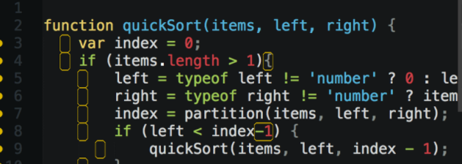
JavaScript Training JS is not perfect but works
Krzysztof Danielewicz
Special thanks to: Maracelina Skopek-Szermik, Anton Horetskyi

Slide 2

About me
.net developer with 7 year experience
Expertise in Front-end technologies: JS, angularJS, CSS
Current assignment Total Cost of Ownership for Volvo Penta
Offline web app using Application Cache
AngularJS
The app estimates maintenance cost of Volvo Penta engines.

Slide 3
Agenda
Understanding JS
scopes, hoisting
Objective JS
prototype, closure, module pattern
ECMAScript5
array functions, strict mode,
Future and necessary fixes
ECMAScript2015, TypeScript, Transpillers

Slide 4

Scopes of variables

Slide 5
Scopes of variable
JavaScript has only two types of scope :
Global scope : Global is nothing but a window level scope. Here, variable present throughout the application.
Functional scope : Variable declared within a function with var keyword has functional scope. Variable declared there are not visible outside.
Notes:
Variable declared in global scopes are avilable
JS Syntax is similar to C syntax languages (Java, C#). Syntax is the same for statements i.e.: while, for, if and function.
lock statements apart from “function” have different behaviour to the modern languages. They do NOT create local scopes with var statement.

Slide 6
“function” create a scope
var temp = ‘OUTER’;
function f1() {
var temp = ‘INNER’;
}
f1();
console.log(temp); // Console prints: ‘OUTER';
Notes:
In this case the global variable temp overrides inside function

Slide 7

“for”, “if”, “while” don’t create a scope
var temp = ‘OUTER’;
for / if / while (…) {
var temp = ‘INNER';
}
console.log(temp); // Console prints: ‘INNER'

Slide 8
IFFE Immediately Invoked Function Expressions
IIFE is a JavaScript function that runs as soon as it is defined.
(function(){
})();
Notes:
Why would you use if?
To Avoid Polluting the Global Scope.
To fix issues with blocks: if, while, for,

Slide 9
Fix with IFFE
var temp = 'outer';
for / if / while (…) {
(function () {
var temp = 'inner’;
})();
}
console.log(temp); // Console prints: 'outer'
Notes:
There is A LOT of closure, function in JS.

Slide 10
ECMA2015 – let + const = JS safe scope
ECMAScript 6 (ES6)/ ECMAScript 2015 (ES2015): The 6th edition of ECMAScript, standardized in 2015
ECMA2015 introduces let and const keywords which create scopes for variables and constant in block statements: if, while, for.

Slide 11
Fix with let
var temp = 'outer';
for / if / while (…) {
let temp = 'inner’;
}
console.log(temp); // Console prints: 'outer'

Slide 12

Hoisting

Slide 13
Hoisting
JavaScript mechanism where variables and function declarations are moved to the top of their scope before code execution.
Examples: hosting.js, hosting.2.js
Notes:
Example hositng

Slide 14
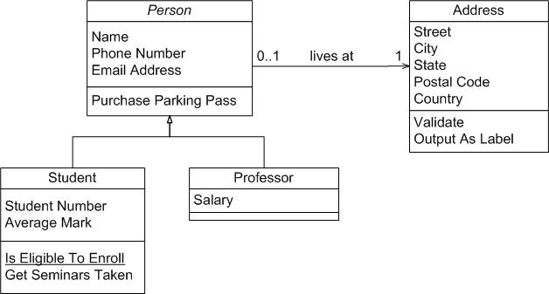
Objective JS

Slide 15
Prototype
var Animal = function(name){
this.name = name;
};
Animal.prototype.makeSound = function () {
return ('('+this.name+')');
};
Notes:
One time method, property is defined for all instance of objects.

Slide 16
Inheritance with prototype
var Cat = function () {
Animal.call(this, "cat");
};
Cat.prototype = Object.create(Animal.prototype);
Cat.prototype.constructor = Cat;
Cat.prototype.makeSound = function(){
var base = Animal.prototype.makeSound.call(this);
return ('meow '+base);
}

Slide 17

Clousure

Slide 18
Clousure
A closure is an inner function that has access to the outer (enclosing) function's variables—scope chain.
The closure has three scope chains:
it has access to its own scope (variables defined between its curly brackets),
it has access to the outer function's variables,
and it has access to the global variables.
Notes:
Usage of closure to emulate private member functions, variables.

Slide 19
Closure example
function makeFunc() {
var name = ‘Volvo’;
function displayNameFn() {
console.log(name);
}
return displayNameFn;
}
var myFunc = makeFunc();
myFunc();
Notes:
More examples VS Code

Slide 20
Module pattern
var MODULE = (function () {
var my = {},
privateVariable = 1;
function privateMethod() {
// ...
}
return { moduleProperty: 1,
moduleMethod: function () {}
};
}());

Slide 21
JS standards - ECMAScript
standard | released | browser support | Major featurs added | Enterprise mode (IE8)
ECMAScript 3 | 1999 | Older browser | Regular Expressions, try/catch | Yes
ECMAScript 5 | 2009 | IE11, all morder browsers | "strict mode", array functions, JSON support | No
ECMAScript 2015 (6) | 2015 | 96%-99% latest Edge, Chrome, FF, Safari | Classes and modules. | No
ECMAScript 2016 (7) | 2016 | 72%-87% Edge, 82% FF, 90% CH | exponential operator, Array includes | No
 |  | base on: http://kangax.github.io/compat-table/es6/

Slide 22
ECMAScript5 – C# Linq vs array function
C# | ECMAScript5
Where() | filter()
Select() | map()
Any() | some()
All() | every()
Aggregate() | reduce()
ForEach()//List | forEach()

Slide 23
ECMAScript5 – strict mode
Strict mode is a way to introduce better error-checking into your code. When you use strict mode, you cannot, for example, use implicitly declared variables, or assign a value to a read-only property, or add a property to an object that is not extensible
“use strict”;
Recommended only for new code and inside iffe. Strange bugs / behavior for legacy code when is turned of.

Slide 24
Strict mode – ECMAScript5
Strict mode is a way to introduce better error-checking into your code.
Restrictions:
Using a variable without declaring it.
Writing to a read-only property.
The value of this is not converted to the global object when it is null or undefined.
Deleting a variable, a function, or an argument.
Notes:
Pragma strict is a way to tell javascript to "be a stricter compiler". That is, it should throw errors when you try to do dumb things that javascript allows. C# is by nature "stricter" and doesn't need to be told to do that.

Slide 25
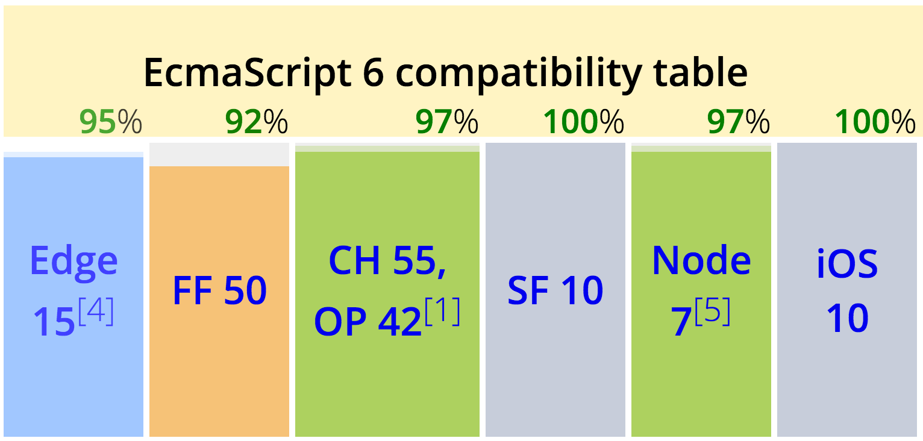
Future – ECMAScript 2015 (6)

Slide 26
Features
Arrow functions
Classes
Template strings
Let + Const
Iterators + For … Of
Modules and much more…
Notes:
Classes doesn’t have private methods

Slide 27

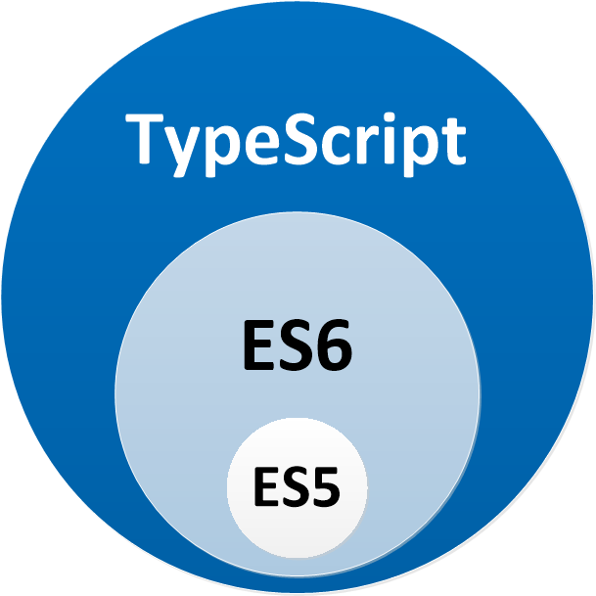
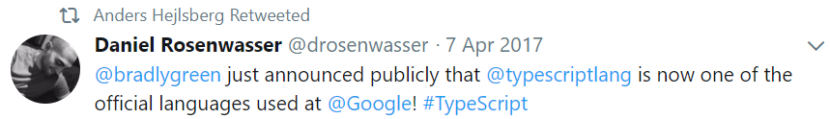

Slide 28

Features
Code with static typing
Annotations
Interfaces, enums
Intellisense
Await / Async
Notes:
Private methods

Slide 29
Hybrid solutions - Transpillers
TypeScript
Tools: node.js tools, Visual Studio, VS Code
allow-js
Type definitions
ECMAScript 2015 (ES6)
BabelJS
Targeting ES 3, ES 5, ES 2015

Slide 30

Q&A

Slide 31
References
https://app.pluralsight.com/library/courses/javascript-from-fundamentals-to-functional-js/table-of-contents
https://developer.mozilla.org/
“JavaScript: The Good Parts”, by Douglas Crockford

Slide 32


